Slide 1

OurVoice
Stronger Together

Slide 2

We are Stronger together
„ Alone we can do so little; together we can do so much.“ - Hellen Keller

Slide 3
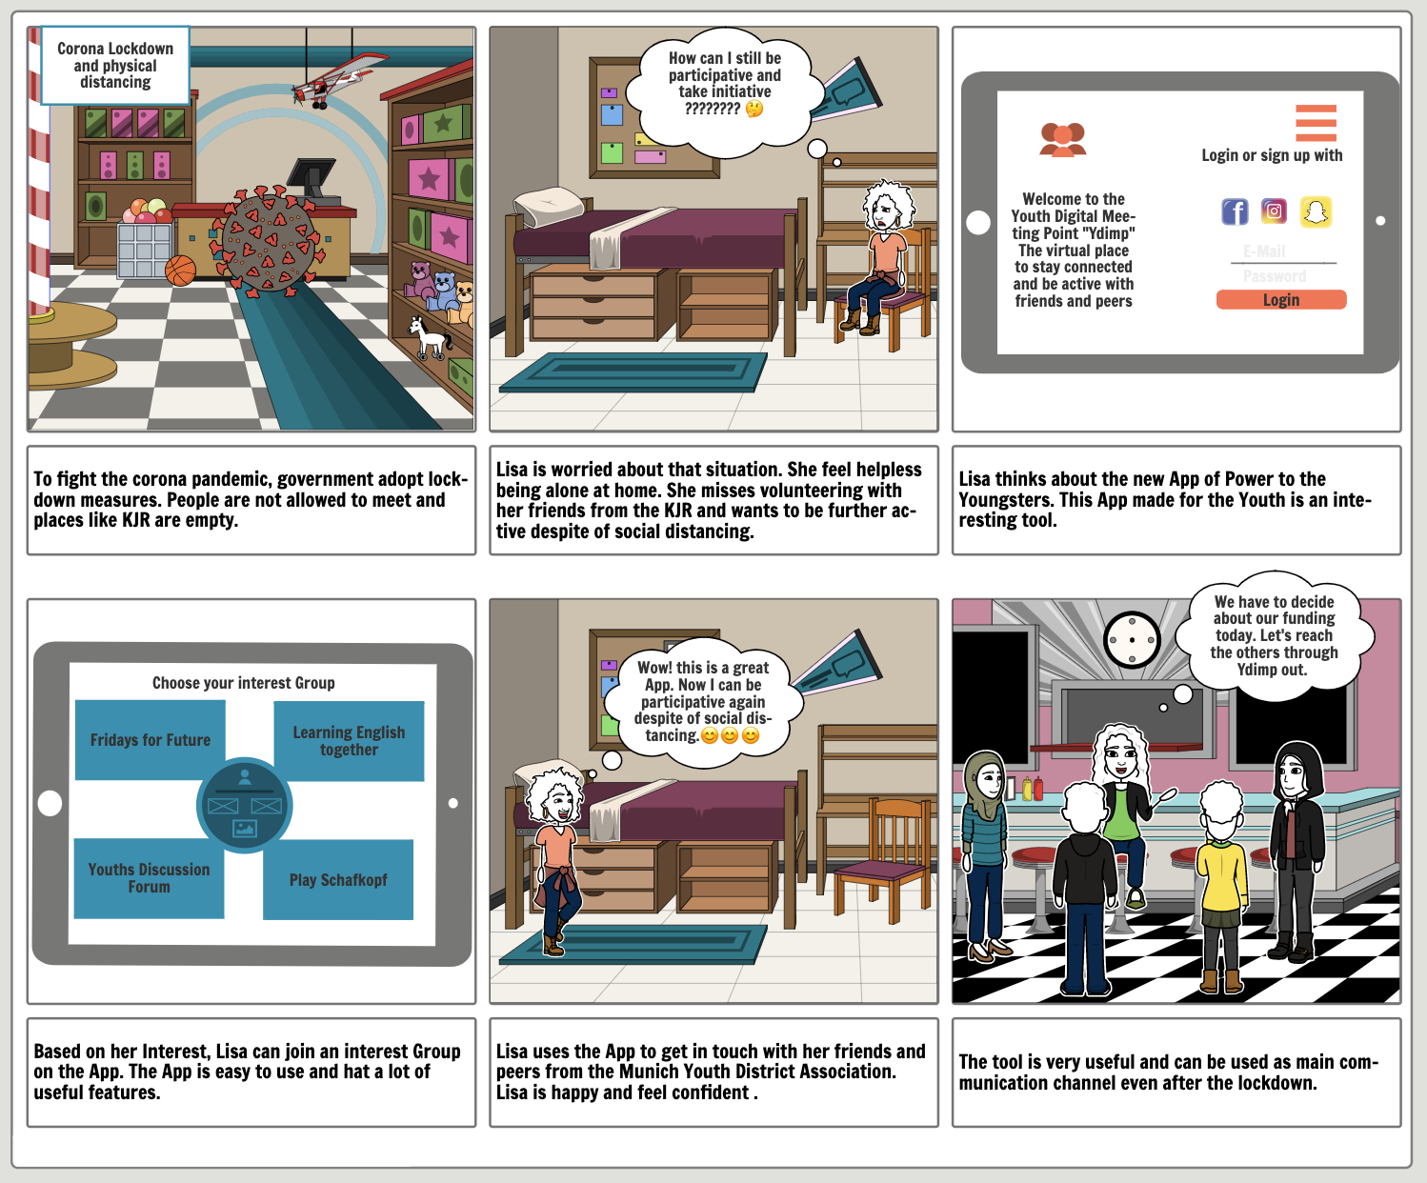
The Problem
Beside digitalization, the pandemic has change everything:
Youngsters and Change Maker feel lonely and limited. They want to come together and take actions
Organizations need a tool to support their specific process
Data protection issue with existing apps
the market misses tools that address specific needs

Slide 4



Our Solution
An application :
that meets data protection requirements where youngsters can join a local or global community and take actions together.
with customizable features that support customer's particular preferences and expectations

Slide 5
Data Protection Concept
Privacy Policy
Technical:
End to End Encryption
Storage in the European Union
Organisational:
Art. 37 GDPR, Art. 38 FDPA - Data Protection Officer
Art 28 GDPR - Processor
Clear formulationof our privacy policy
Art. 6 GDPR – Lawfulness of processing
Art. 7 GDPR – Conditions for consent and withdrawal at any time
- GDPR : General Data Protection Regulation
- FDPA : German Federal Data Protection Act

Slide 6

OurVoice Stronger Together
OurVoice is a digital Hub for change Making and Hope Building. This is an App for Youth by Youth.
Mission: Promote new form of engagement by bringing youngsters and change maker together to take actions in a world that needs it.“

Slide 7
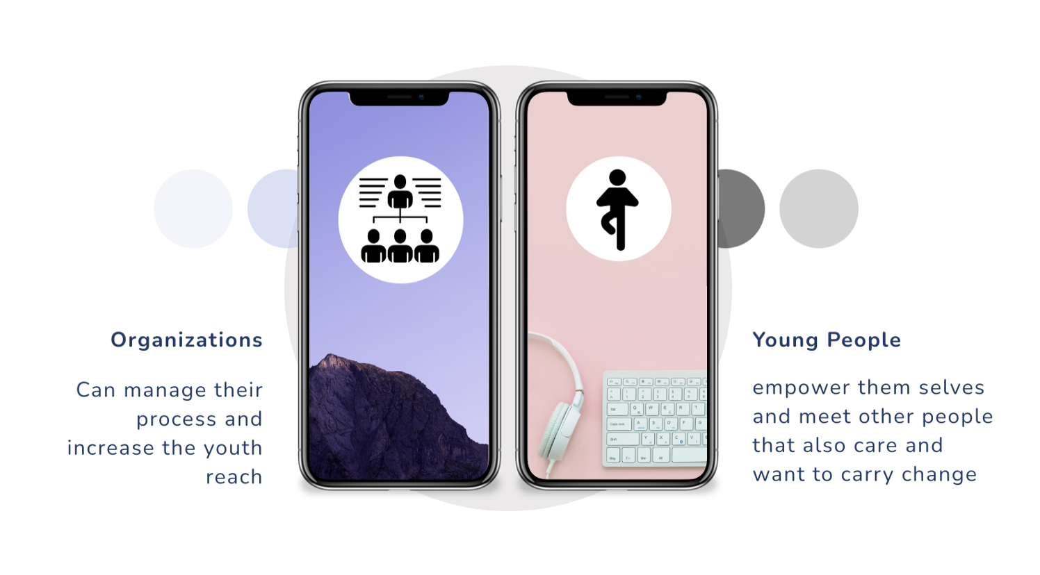
2 Sides of our market

Slide 8



Business Model
Our Revenues come from Licensing, Software Customising, Advertisement, Membership fee, Content Management and Data Analytics fee
Basic Version with Ads
Licensing fee for pro Version
Content Management fee
Custom Feature development fee
Basic Version with Ads( Pay per Click)
Fee for Custumer Trends

Slide 9
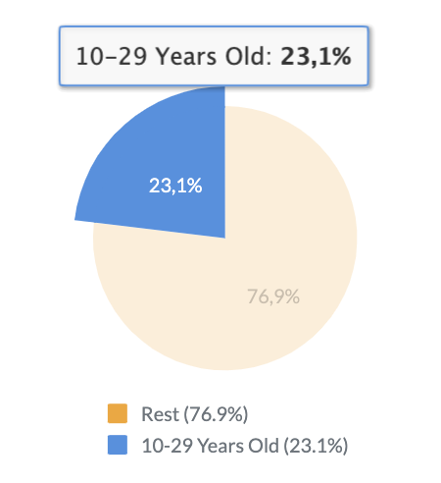
The Market
Organisations :
For instance the German Federal Youth Association with 29 youth organisations, 16 regional youth councils and seven affiliated organisations
Young People : 0,36 Mio

Slide 10
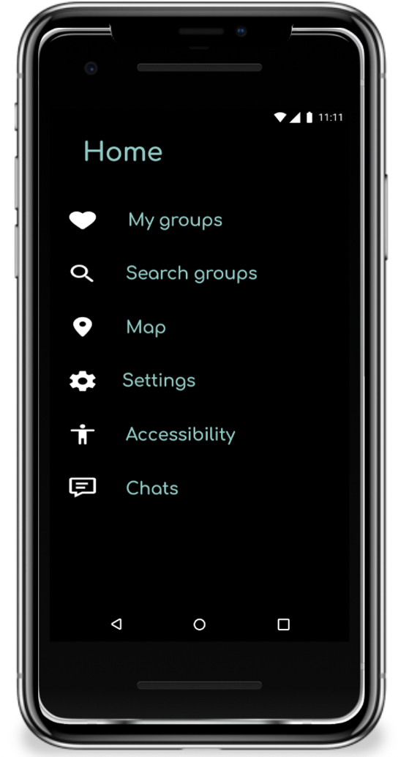
Feature Overview and DemO
Connect with local and global Organizations
Voting Polls and starting initiatives
Shared Ressources, online Events via Newsfeed and Interest Group

Slide 11
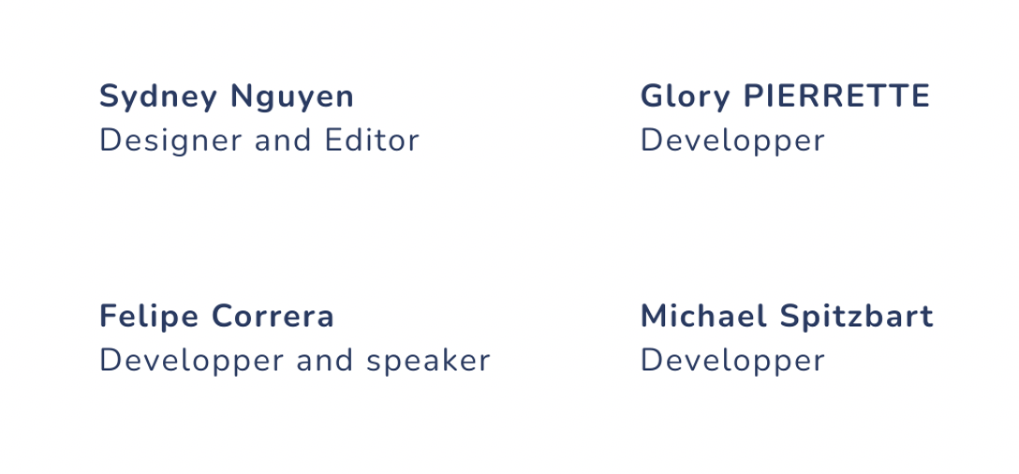
The Team behind our App

Slide 12
Our Challenge Contribution
Nail the Problem
Problem Statement
Empathy Map
Press Release
Storyboard
Bring a solution
Ideation
Prototype & Test
Business Model

Slide 13
Reflection on GXC international virtual innovation challenge
Good planification
Learning Experience
Challenging and Confusing
Innovation process
Prototyping
Entrepreneurial Mindset
…
Dare

Slide 14

Thank You

